Slide 1

Introduction to R
28/10/2019

Slide 2







Who are we?
Thomas Bayley
Naomi Gibbs
Robert Smith
Paul Schneider
Sarah Bates
Amy Chang

Slide 3
Timetable
Time | Section | Who?
13:00 – 13:10 | Welcome
13:10 – 13:20 | Introductions – why are you here? | Led by Naomi
13:20 – 13:25 | Short Presentation | Led by Rob
13:25 – 13:30 | Teaching methods | Led by Amy
13:30 – 14:15 | Session 1 – BASICS | Led by Rob
14:15 – 14:30 | Break – 15mins
14:30 – 15:15 | Session 2 – OBJECTS | Led by Naomi
15:15 – 13:30 | Break – 15mins
15:30 – 16:15 | Session 3 –WORKING WITH DATA | Led by Tom
16:15 – 16:30 | Break – 15mins
16:30 – 16:45 | Recap & Extras | Led by Rob & Tom
16:45 – 17:00 | Feedback and course development | Led by Naomi

Slide 4
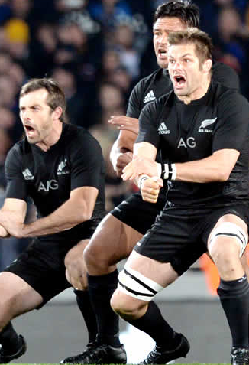

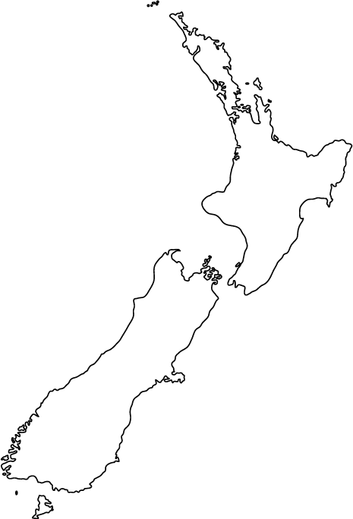


What is R?
Programming language & free software environment.
Mainly used for statistical and graphical techniques.
Able to produce fantastic publication-quality plots.
Base-R is good, Base-R + additional packages is awesome.

Slide 5
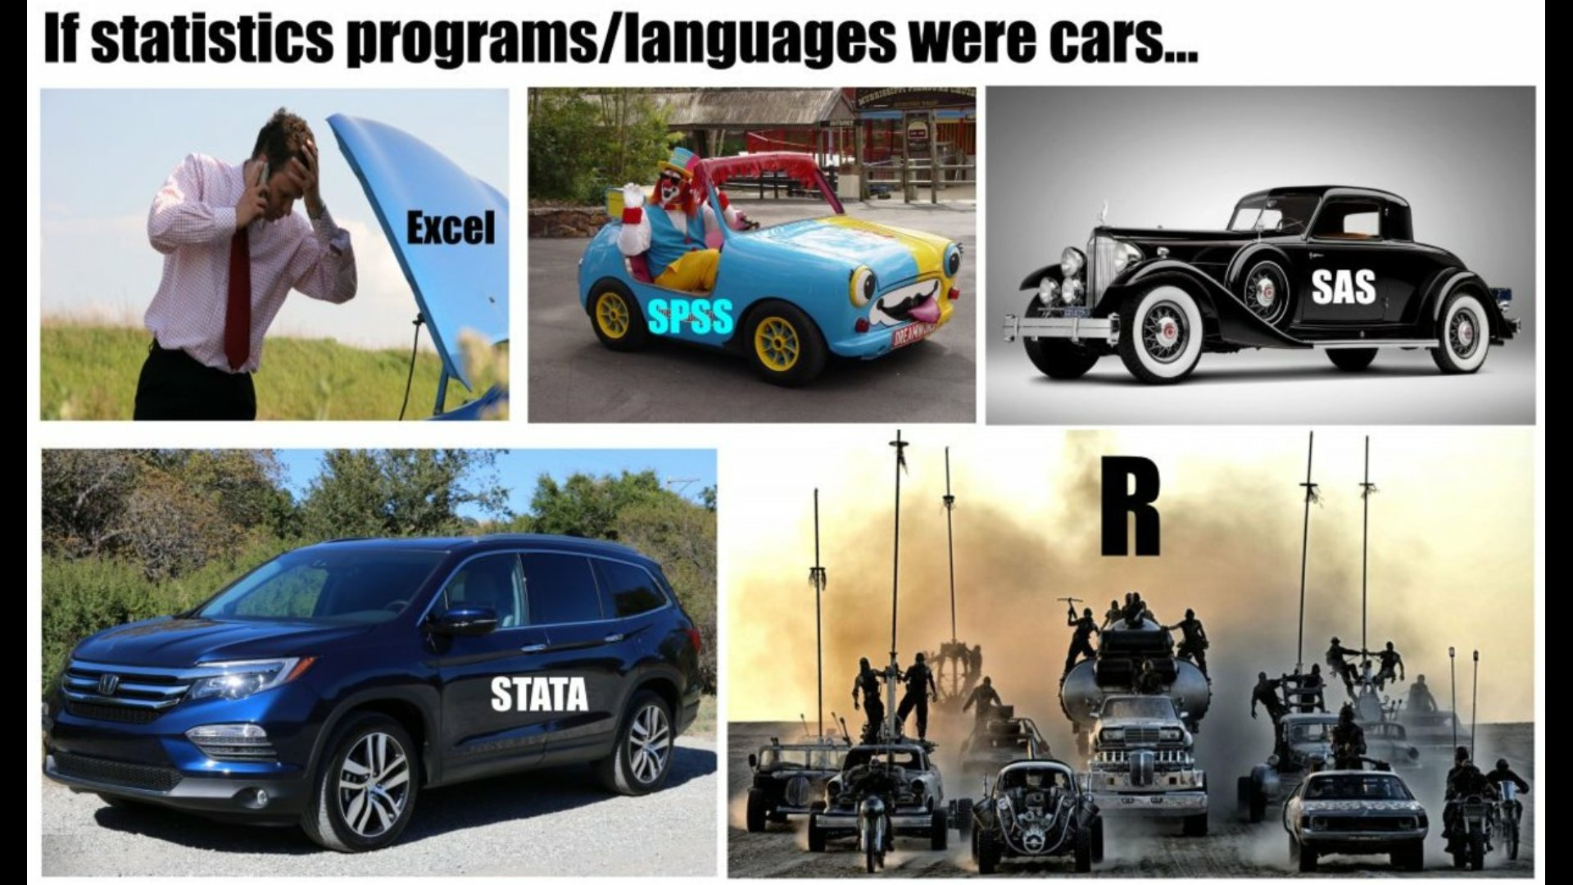
Why learn R? – opportunity cost.

Slide 6
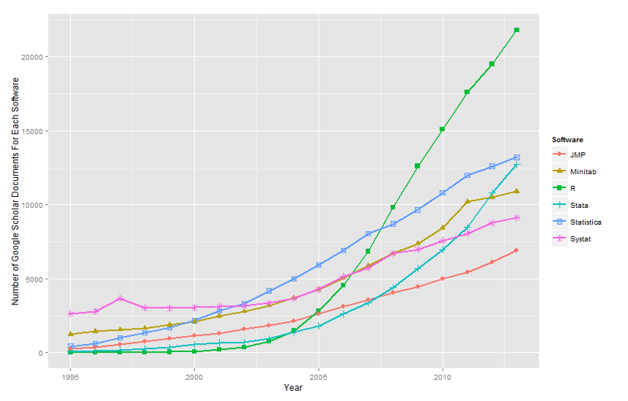
Why learn R? – collaboration.

Slide 7
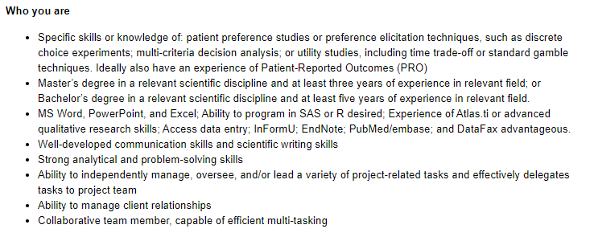
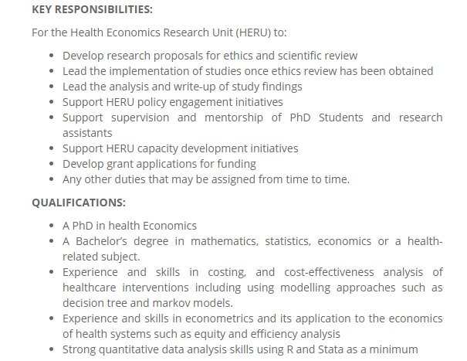
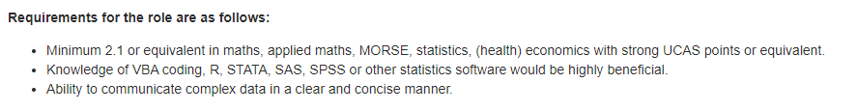
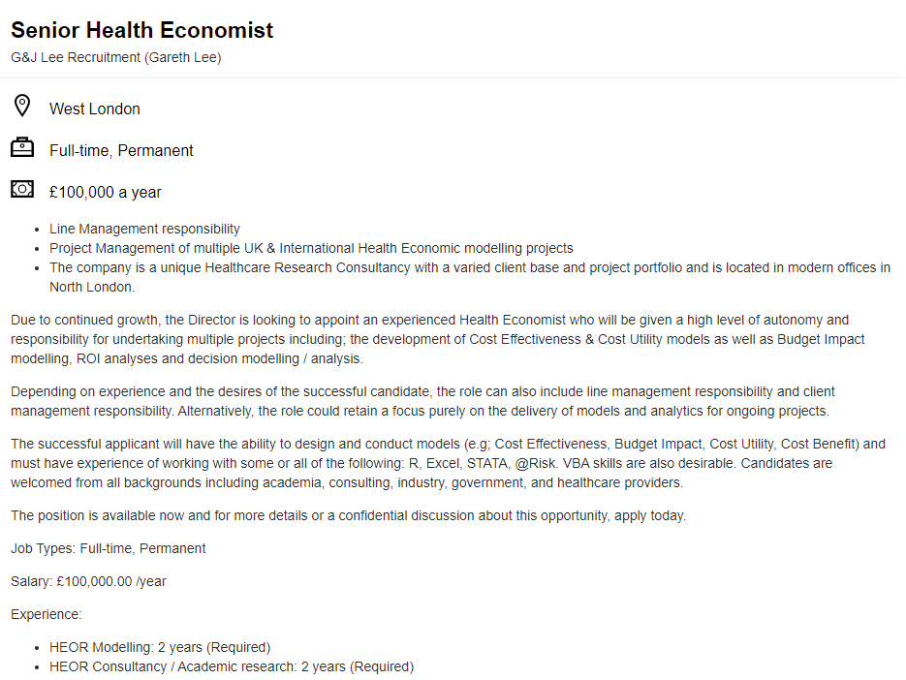
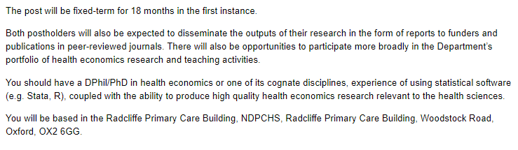
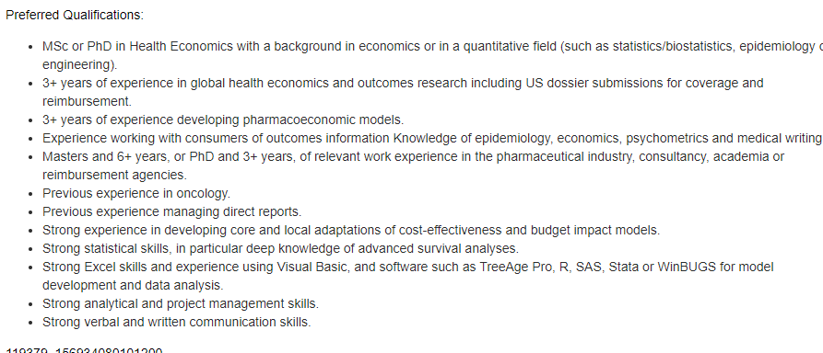
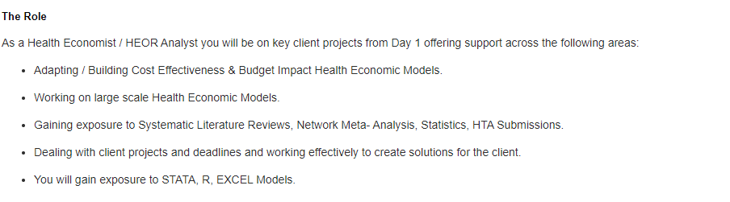
Why learn R? – employability

Slide 8

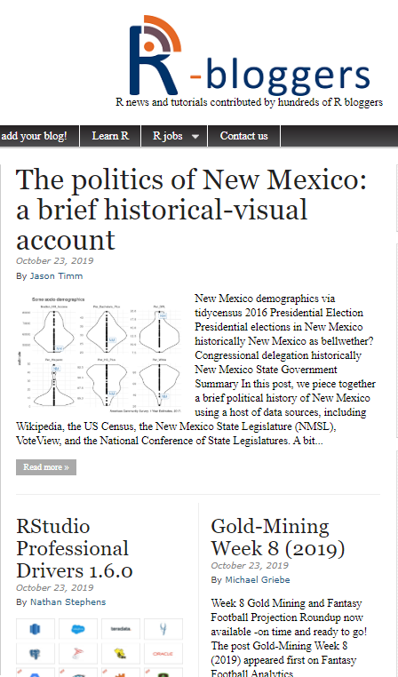
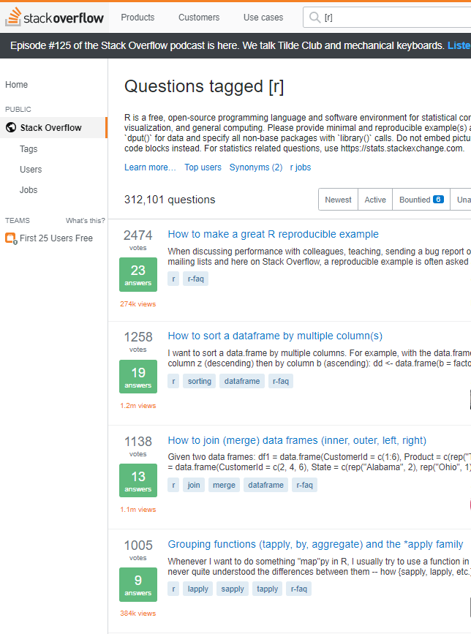
Why learn R? – community.
https://r4ds.had.co.nz/

Slide 9
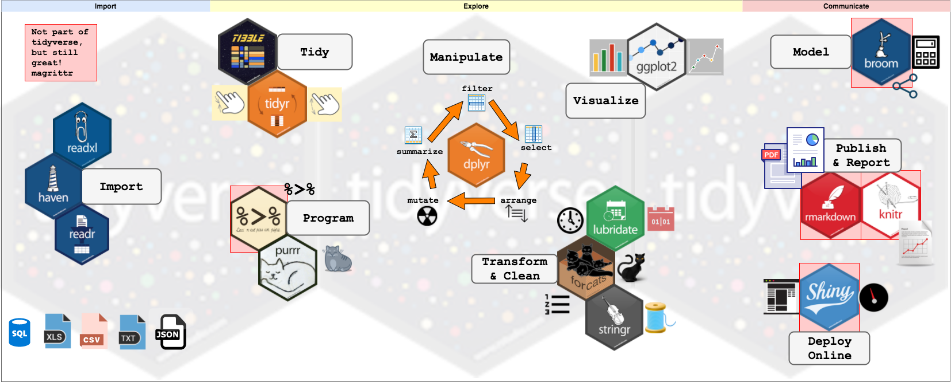
Why learn R? – flexibility

Slide 10
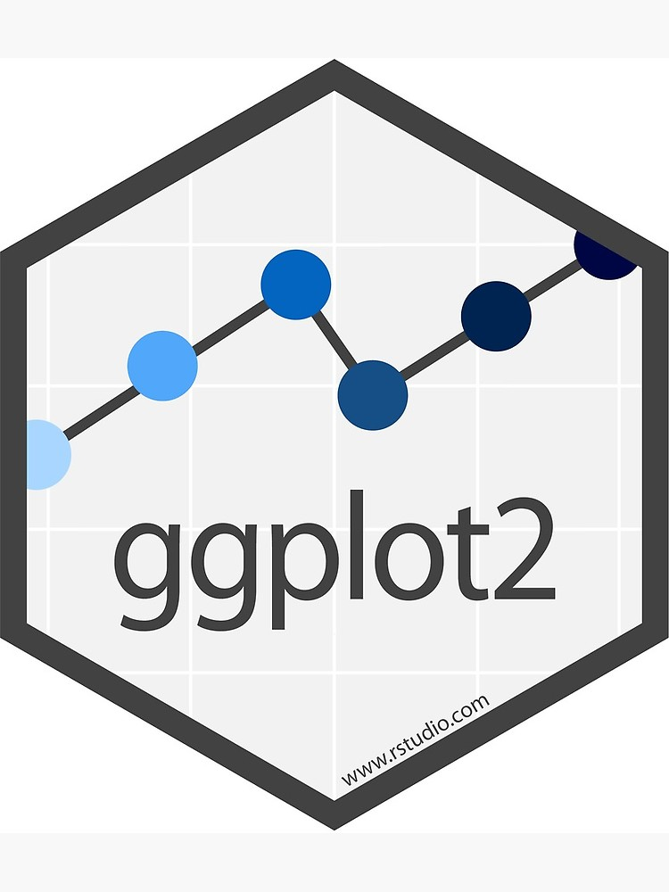

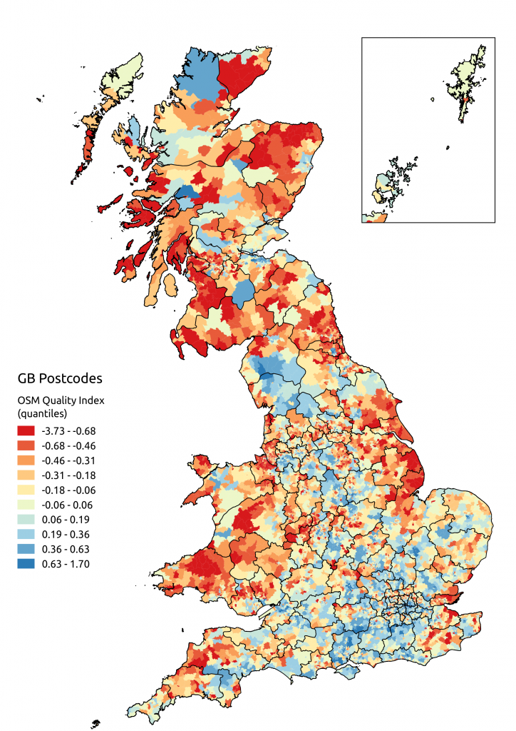
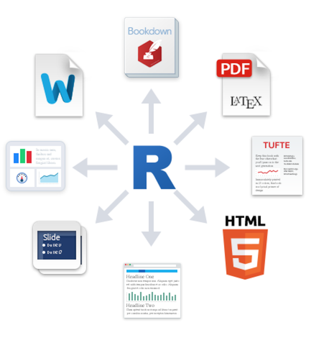
Course Document
Link to graph gallery
Course Document

Slide 11


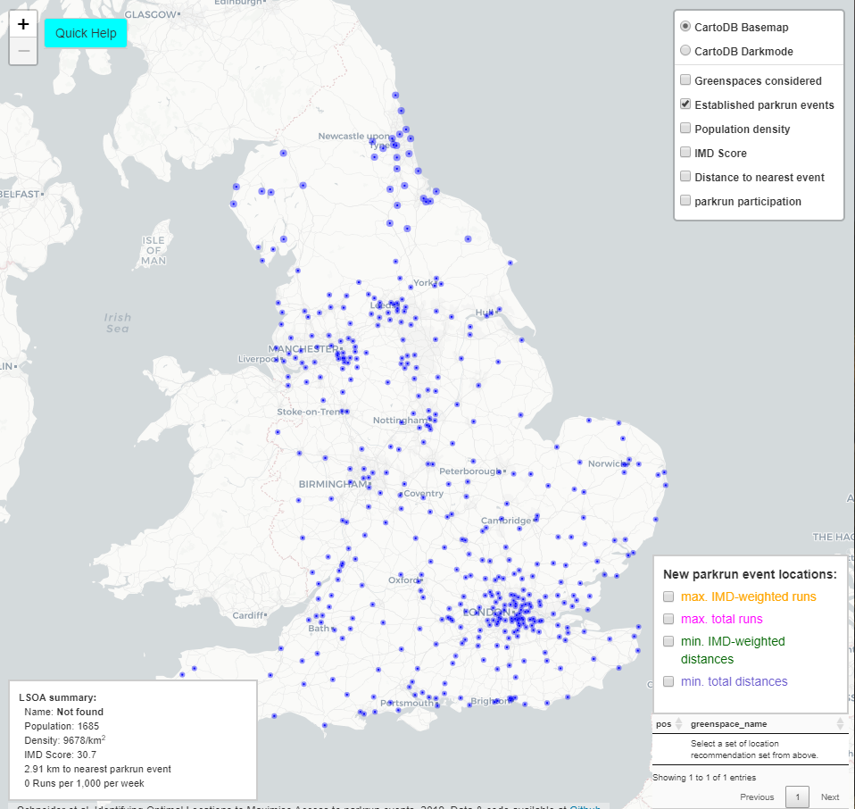
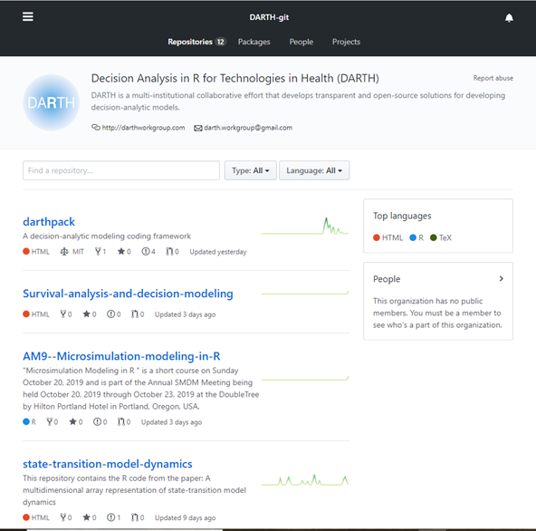
http://iol-map.shef.ac.uk/
https://github.com/DARTH-git

Slide 12
Why use R for decision modelling?
Input
Model
Output
Plots
Present

Slide 13
Why use R for decision modelling?
Input
Model
Output
Plots
Present

Slide 14
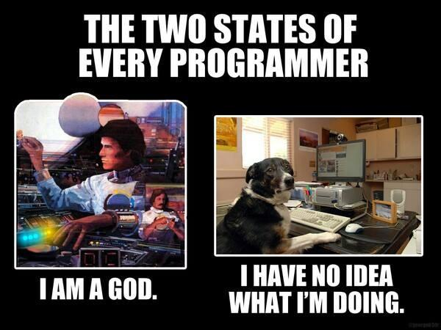

Slide 15
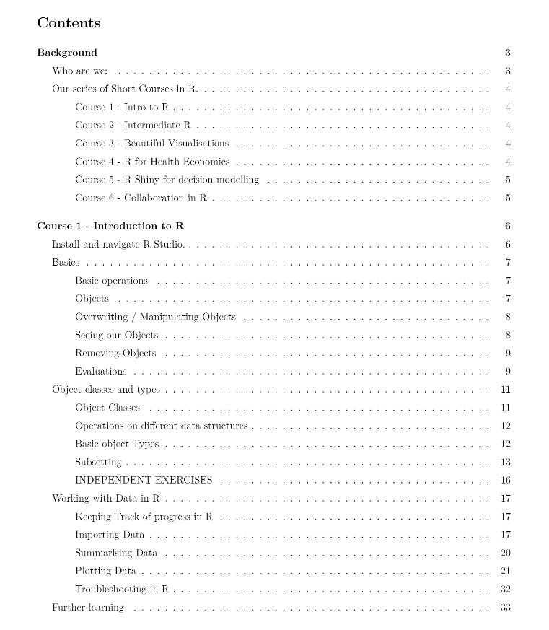

Let’s begin…
https://bitowaqr.github.io/ScHARRR_intro/index.html

Slide 16
Extra Slides

Slide 17



Why is R useful?

Slide 18
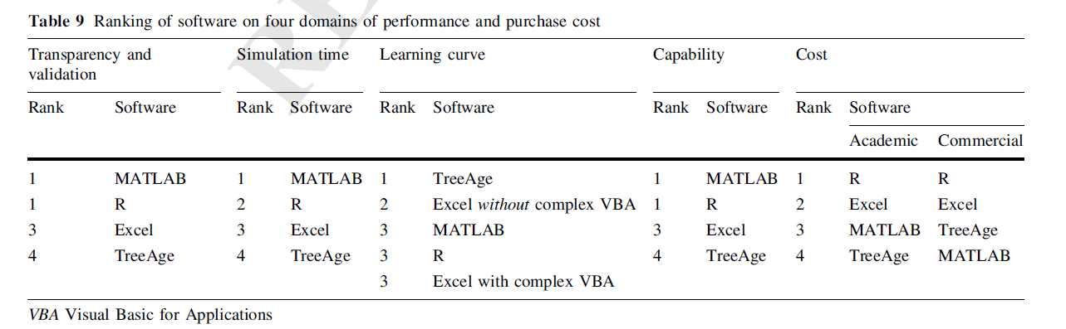
R for Decision Modelling?
Hollman, C., Paulden, M., Pechlivanoglou, P. and McCabe, C., 2017. A comparison of four software programs for implementing decision analytic cost-effectiveness models. Pharmacoeconomics, 35(8), pp.817-830.

Slide 19
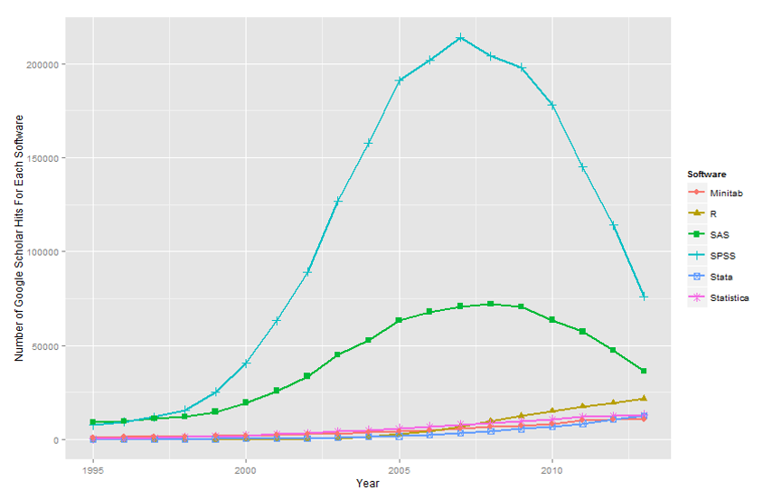

Slide 20
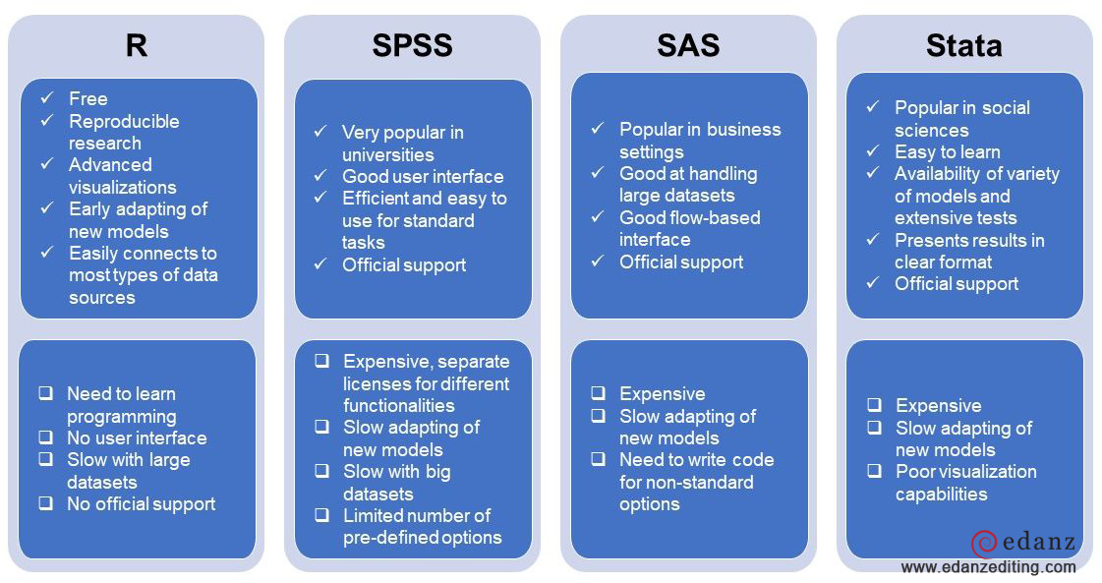
Why learn R?
Notes:
Replication – automate a process (e.g. copy/pasting).
Flexible –tidy/reformat large datasets.
Analysis – regression, time series, survival analysis.
Merging – combining multiple (3+) datasets.
Report – incorporating methods & output into a document.
Engagement – Shiny interface to increase stakeholder engagement.
Transparency - Open source research.
Price - It’s free … completely free … zero cost … zilch!
Knowledge - Huge and growing network for help.

Slide 21
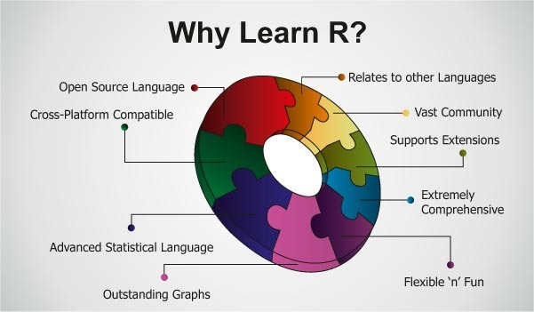

Slide 22
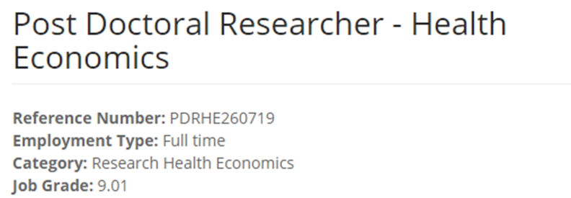

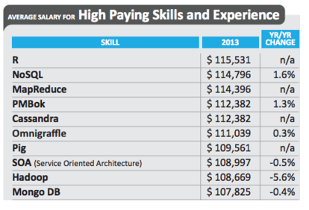
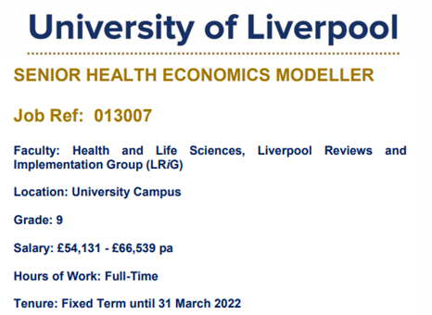
Why R?
2014 Dice Tech Salary Survey Report

Slide 23

https://www.datanami.com/2019/08/15/is-python-strangling-r-to-death/

